Slide 1
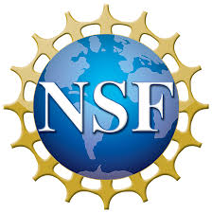
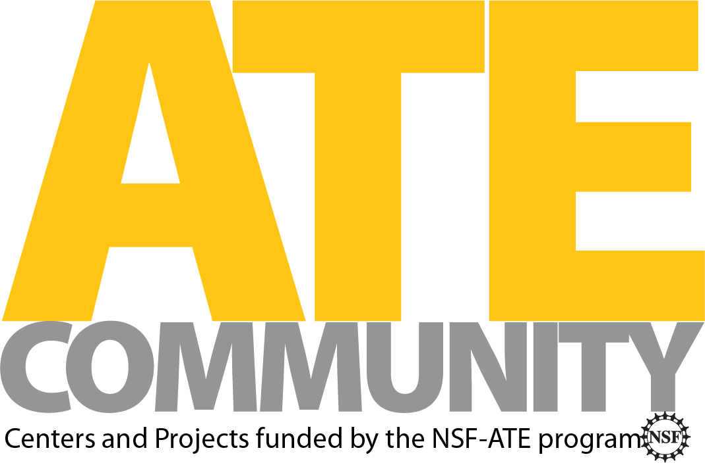
Virtual Reality Implementation for a Scanning Electron Microscope
Utah Valley University
Matthew Meyers
Dr. Rezal Kamali-Sarvestani, Dr. Paul Weber, Scott Kaiser, Cody Anderson,
UVU ECE and Physics Departments

Slide 2
The course:
This Fall UVU is introducing a nanotechnology course:
Lectures once a week
Labs once a week
VR simulations
Introduces elements of nanotechnology fabrication (photolithography, EBL, sputtering, etching) and characterization (microscopy, and SEM)

Slide 3
VR Simulations’ Goals
Train students in the exact equipment they will be using for labs
Students won’t be intimidated by new equipment on first encounter
Students will have a stronger sense of how it works beforehand
Students will avoid costly mistakes that lose time and/or damage equipment

Slide 4
VR Strengths
Visualize things that cannot be seen in the real-world
Cost friendly - institutions that cannot afford nanotechnology machinery can afford VR
Low risk - no worry about students being exposed dangerous chemicals or damaging costly equipment

Slide 5
VR Weaknesses
Restricted by currently available technology
Lack of true realism due to processing time/power
It can be difficult to read
Lack of dexterity due to need to use controllers
Some forms of movement can cause motion sickness
Loss of real-world awareness carries risks of injury
Walking into wall, etc.

Slide 6
Types of Simulations
Photolithography - use of spin coater, photoresist, preparation of wafer sample, exposing pattern, developing
SEM - use of scanning electron microscope
Plasma Etching - use of plasma etching machine to remove material from sample
Sputter Deposition - operation of two-stage vacuum system, diffusion pump, creating a thin layer sample coating by sputtering
Nanomanufacturing Facility Interior - tour of facility based on I.M. Flash in Lehi, UT

Slide 7
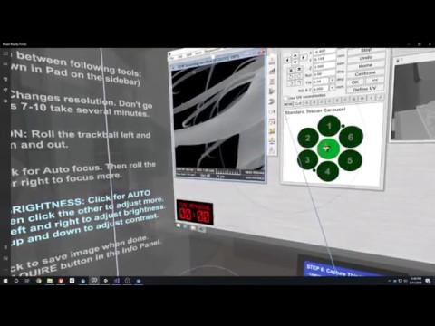
SEM Simulation
Notes:
Explain the sounds
Sputter coating metalicizes the sample so it conducts the electrons
Talk about cross-section
Talk about three parameters: scan speed, focus, brightness/contrast
How much of the ant can actually be explored
Talk about grading and difficulty settings

Slide 8
Conclusion
UVU is using virtual reality in its nanotechnology education in order to help more students prepare for using the real world machines while reducing risks, increasing lab safety, and providing relevant experience that will help them further their goals.
Than
Dr. Reza Kamali-Sarvestani and Dr. Paul Weber
THANK
YOU!
Grant 1700695

